Slide 1

Clicker Questions
Chapter 5
Covalent Bonds and Molecular Structure
Donald Linn
Indiana University–
Purdue University Fort Wayne
Fort Wayne, IN
© 2014 Pearson Education, Inc.

Slide 2
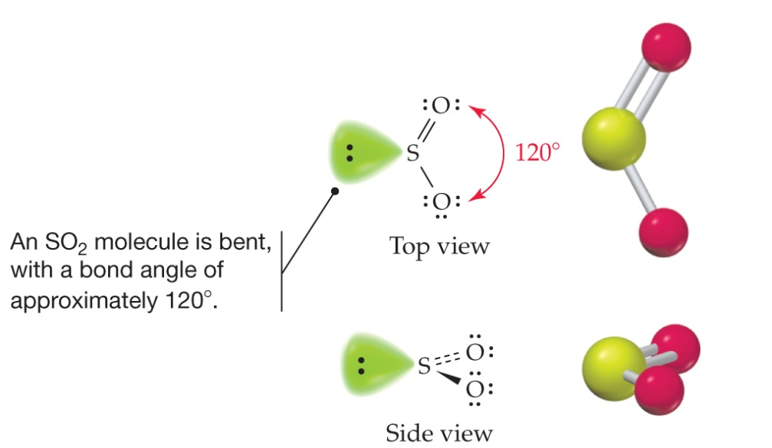
What is the hybridization of sulfur in SO₂?
a) s
d) sp³
b) sp
e) spd
c) sp²
© 2014 Pearson Education, Inc.
Notes:
Answer: c

Slide 3
What is the hybridization of sulfur in SO₂?
a) s
d) sp³
b) sp
e) spd
c) sp²
© 2014 Pearson Education, Inc.
Notes:
Answer: c

Slide 4
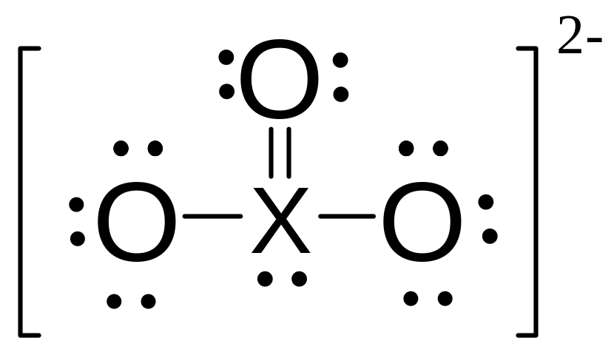
What is the fourth-row element that forms the
ion below?
a) Ge
c) As
e) None of these
b) Se
d) Kr
© 2014 Pearson Education, Inc.
Notes:
Answer: b

Slide 5
What is the fourth-row element that forms the
ion below?
a) Ge
c) As
e) None of these
b) Se
d) Kr
© 2014 Pearson Education, Inc.
Notes:
Answer: b

Slide 6
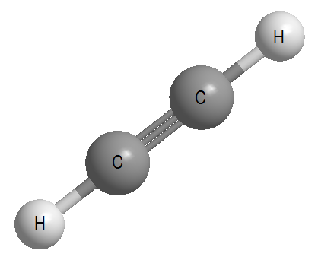
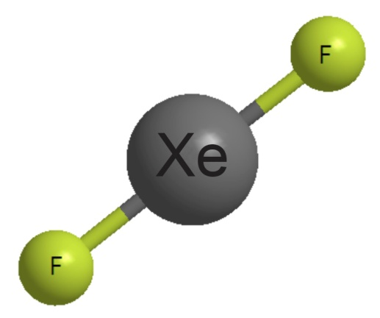
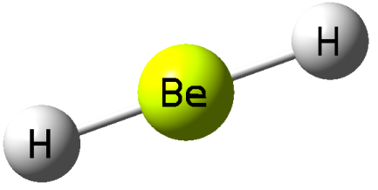
What do the three molecules to the right have in common?
a) They are all linear about
the central atoms.
b) All central atoms are sp hybridized.
c) Both a and b are correct.
d) Neither a nor b are correct.
© 2014 Pearson Education, Inc.
Notes:
Answer: a

Slide 7
What do the three molecules to the right have in common?
a) They are all linear about
the central atoms.
b) All central atoms are sp hybridized.
c) Both a and b are correct.
d) Neither a nor b are correct.
© 2014 Pearson Education, Inc.
Notes:
Answer: a

Slide 8
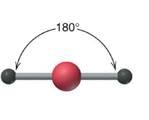
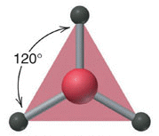
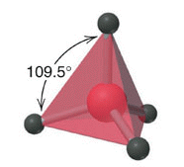
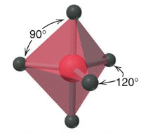
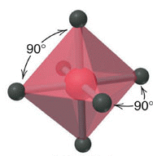
Draw the Lewis structure for SF₄.
The electron group geometry for SF₄ is
a)
b)
linear.
trigonal
Planar.
c)
d)
e)
tetrahedral.
trigonal
bipyramidal.
Octahedral.
© 2014 Pearson Education, Inc.
Notes:
Answer: d

Slide 9
Draw the Lewis structure for SF₄.
The electron group geometry for SF₄ is
a)
b)
linear.
trigonal
Planar.
c)
d)
e)
tetrahedral.
trigonal
bipyramidal.
Octahedral.
© 2014 Pearson Education, Inc.
Notes:
Answer: d

Slide 10
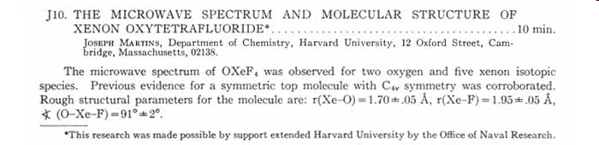
Draw the Lewis structure for xenon oxytetrafluoride and determine the geometry about Xe.
a) Trigonal pyramidal
b) Trigonal bipyramidal
c) Square pyramidal
d) Octahedral
e) Tetrahedral
© 2014 Pearson Education, Inc.
Notes:
Answer: c

Slide 11
Draw the Lewis structure for xenon oxytetrafluoride and determine the geometry about Xe.
a) Trigonal pyramidal
b) Trigonal bipyramidal
c) Square pyramidal
d) Octahedral
e) Tetrahedral
© 2014 Pearson Education, Inc.
Notes:
Answer: c

Slide 12
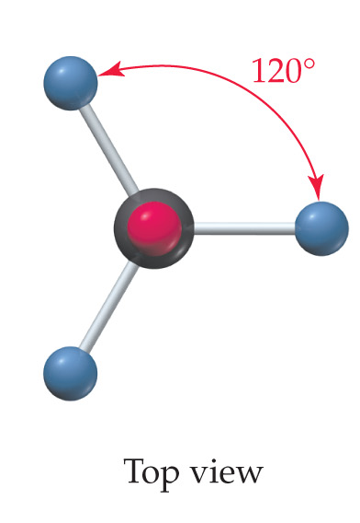
Shown below is a model of SiCl₄ having an orientation in which one or more atoms are hidden from view.
What is the indicated bond angle?
a) Less than 109.5°
b) 109.5°
c) Greater than120°
d) 120°
e) Less than 120° but
greater than 109.5°
© 2014 Pearson Education, Inc.
Notes:
Answer: b

Slide 13
Shown below is a model of SiCl₄ having an orientation in which one or more atoms are hidden from view.
What is the indicated bond angle?
a) Less than 109.5°
b) 109.5°
c) Greater than120°
d) 120°
e) Less than 120° but
greater than 109.5°
© 2014 Pearson Education, Inc.
Notes:
Answer: b

Slide 14
Mustard gas is a cytotoxic blistering agent and was first used by the German army against the British and French armies in World War I. The condensed structural formula for mustard gas is (ClCH₂CH₂)₂S. Draw the Lewis structure and determine the geometry about the carbon atoms and the
sulfur atom.
The geometry about S is
a) linear.
d) trigonal pyramidal.
b) trigonal planar.
e) bent.
c) tetrahedral.
© 2014 Pearson Education, Inc.
Notes:
Answer: e

Slide 15
Mustard gas is a cytotoxic blistering agent and was first used by the German army against the British and French armies in World War I. The condensed structural formula for mustard gas is (ClCH₂CH₂)₂S. Draw the Lewis structure and determine the geometry about the carbon atoms and the
sulfur atom.
The geometry about S is
a) linear.
d) trigonal pyramidal.
b) trigonal planar.
e) bent.
c) tetrahedral.
© 2014 Pearson Education, Inc.
Notes:
Answer: e

Slide 16
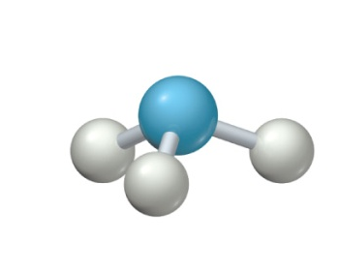
What is the bond angle in the following molecular model of ammonia?
a) Less than 109.5°
b) 109.5°
c) Less than 120°
but greater
than 109.5°
d) 120°
e) None of
the above
© 2014 Pearson Education, Inc.
Notes:
Answer: a

Slide 17
What is the bond angle in the following molecular model of ammonia?
a) Less than 109.5°
b) 109.5°
c) Less than 120°
but greater
than 109.5°
d) 120°
e) None of
the above
© 2014 Pearson Education, Inc.
Notes:
Answer: a

